Slide 1
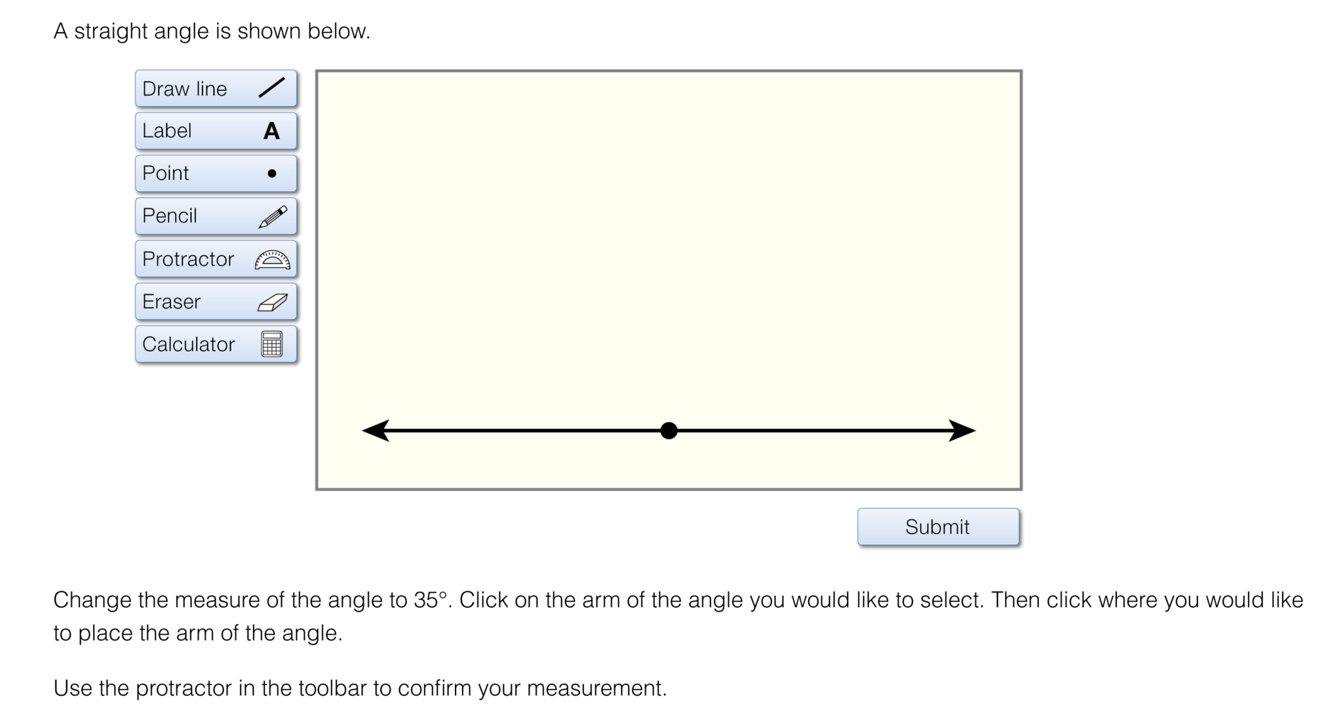
Item Exemplars:
Technology Enhanced and Constructed Response

Slide 2
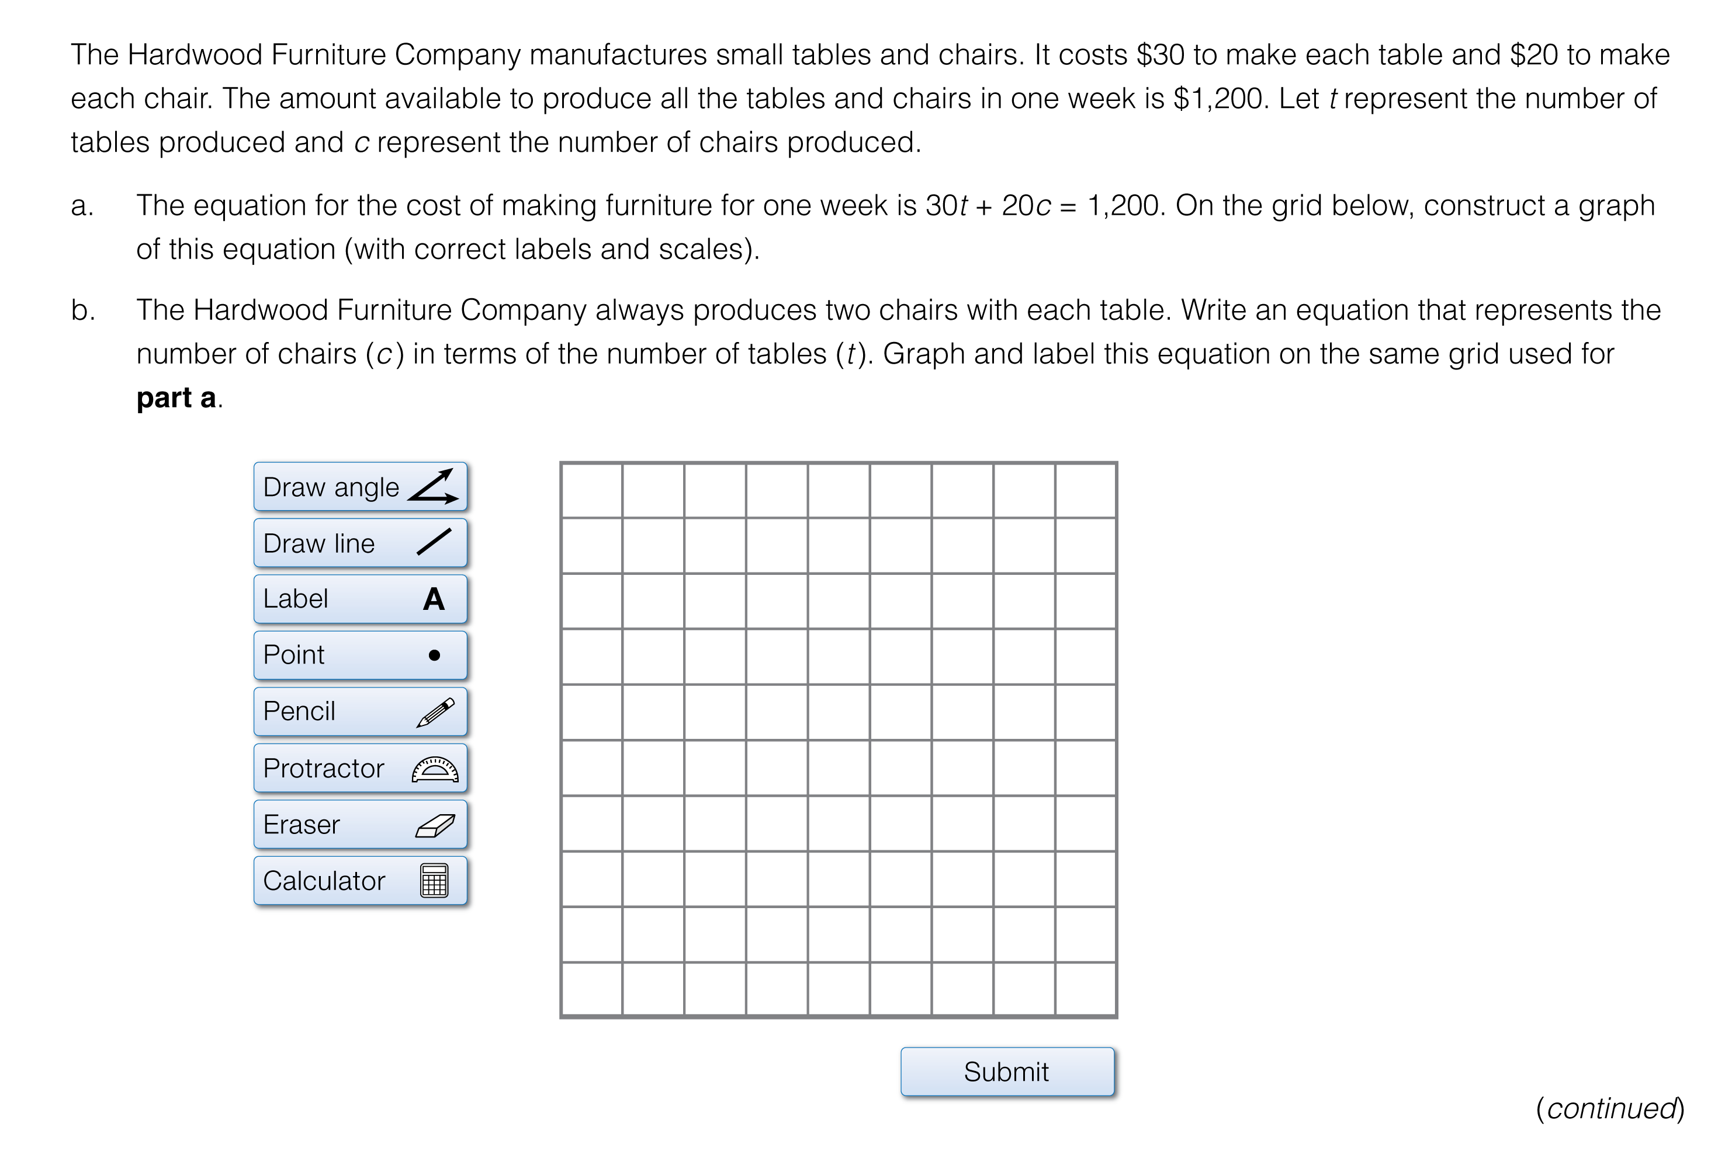
Item Exemplars:
Technology Enhanced and Constructed Response

Slide 3
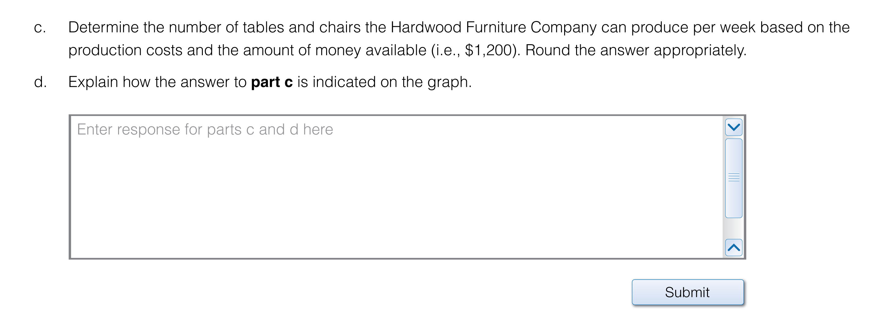
Item Exemplars:
Technology Enhanced and Constructed Response

Slide 4
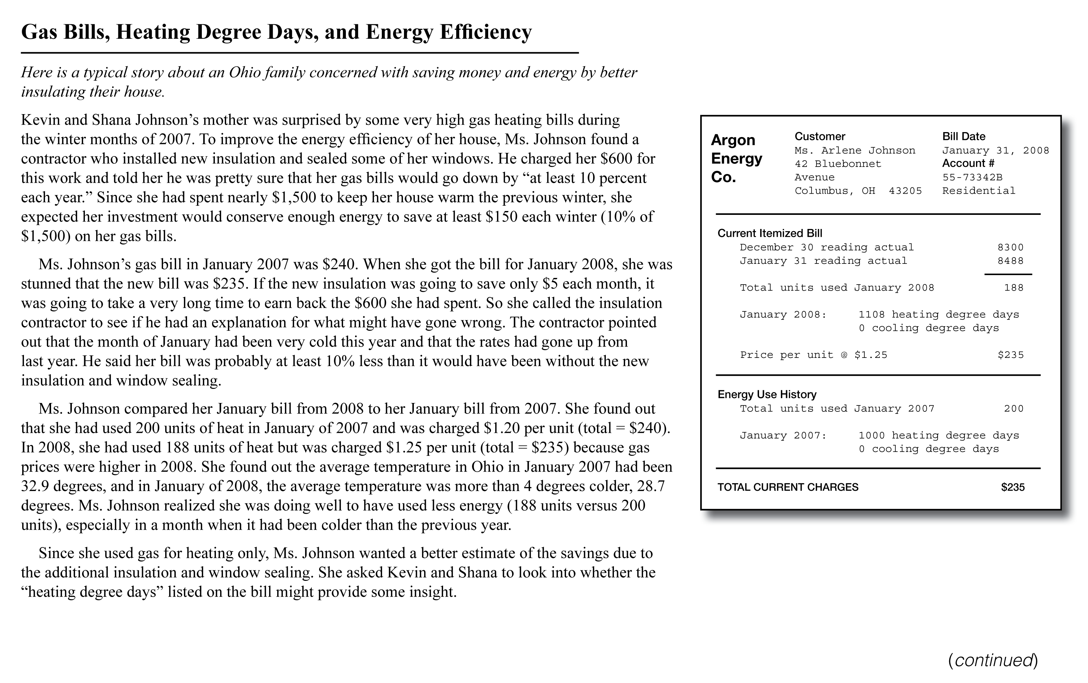
Item Exemplars:
Performance Task
Performance Task drawn from the Ohio Performance Assessment Project.

Slide 5
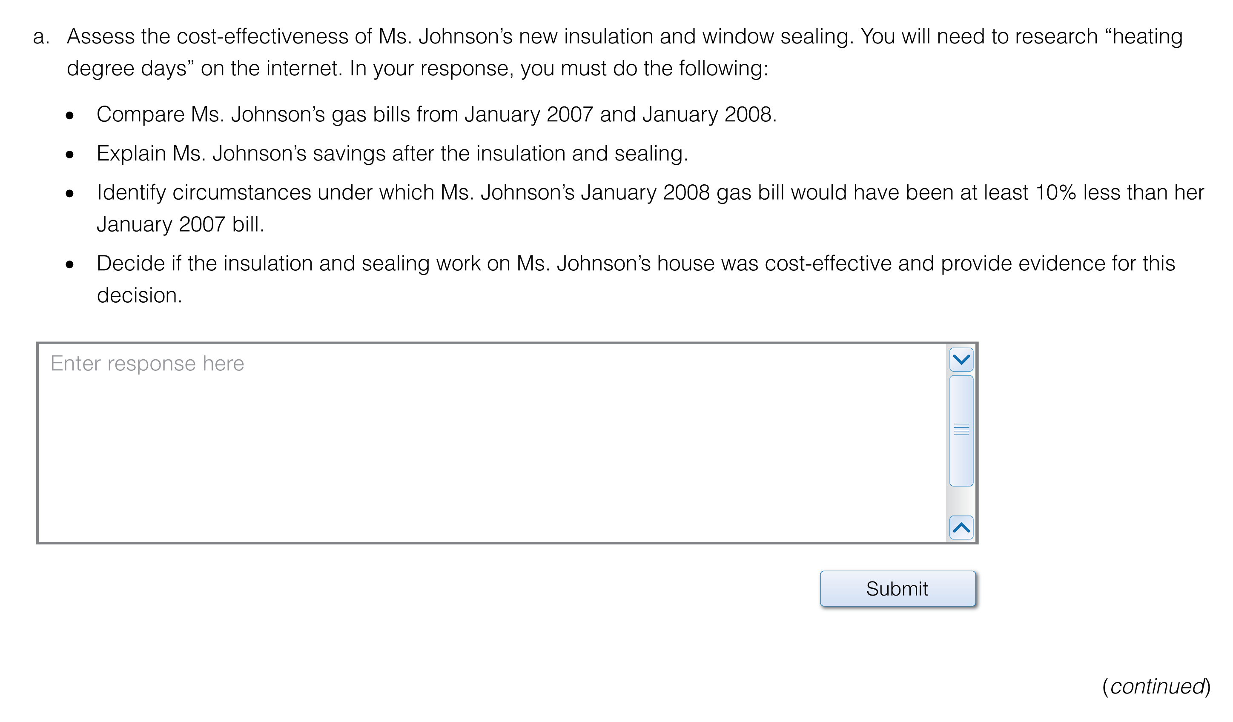
Item Exemplars:
Performance Task (cont’d)
Performance Task drawn from the Ohio Performance Assessment Project.

Slide 6
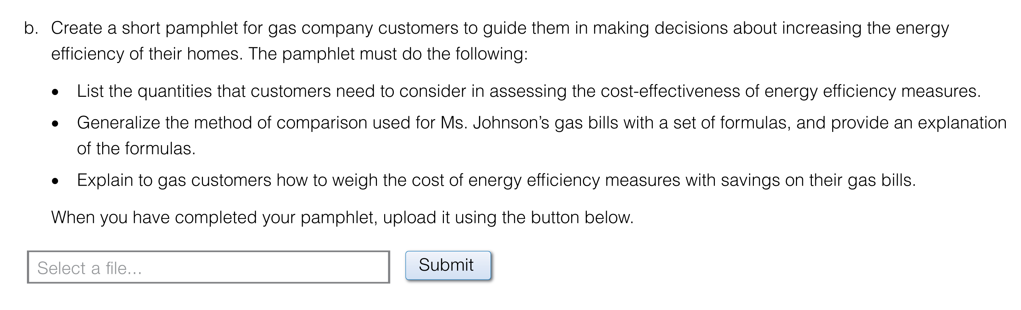
Item Exemplars:
Performance Task (cont’d)
Performance Task drawn from the Ohio Performance Assessment Project.

